Slide 1

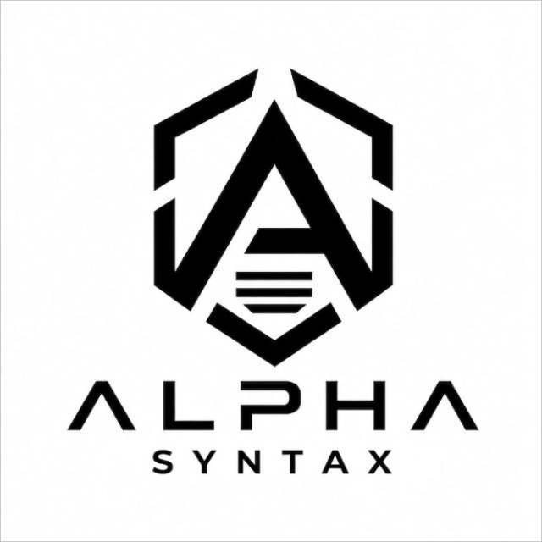
People's Priorities
AI-Powered Constituency Intelligence for Evidence-Based Development Planning
Team: Alpha Syntax
Build with AI – Code for Communities
Hack2Skill

Slide 2
The Governance Planning Gap
Current Challenges
MPs receive requests from
Public meetings
Letters
WhatsApp
Social media
Grievance portals
Thousands of requests are unstructured.
Multiple citizens report the same issue.
Fake campaign submissions distort priorities.
No objective way to compare competing projects.
Letters, WhatsApp, Voice, Photos, Meetings
Thousands of Requests
Manual Decision
Slow Biased Difficult
Current planning relies heavily on fragmented information instead of consolidated evidence.

Slide 3
People's Priorities
Citizen
Voice/Text/Image
AI Understanding
Demand Clustering
Public Data Integration
Priority Engine
Budget Optimizer
MP Dashboard
Citizen Tracking
A multilingual AI-powered constituency planning platform that converts citizen suggestions into transparent, explainable, budget-aware development recommendations.
From citizen voices to evidence-based public investment.

Slide 4
System Architecture
Citizen
Multimodal Intake
Translation / Speech-to-Text / OCR
AI Parser
Semantic Clustering
Campaign Detection
Public Data / Development Plans
Priority Scoring Engine
Budget Optimization
MP Dashboard
Citizen Feedback Loop
Technology Stack: Next.js | Supabase PostgreSQL | Gemini AI | Leaflet | Recharts | pgvector

Slide 5
AI Intelligence Pipeline
AI Understanding
Translation
OCR
Speech Recognition
Classification
Semantic Intelligence
Duplicate Detection
Campaign Detection
Hotspot Identification
Recommendation Engine
Priority Ranking
Budget Allocation
Explainability
Evidence Engine
Population
Infrastructure
Education
Roads
Water
Health
Every recommendation is supported by citizen demand and public evidence.

Slide 6
Explainable Priority Scoring
Factor | Weight
Demand Intensity | 20%
Population Impact | 15%
Infrastructure Gap | 15%
Equity Need | 15%
Urgency | 15%
Feasibility | 10%
Strategic Alignment | 10%
Trust Score | 5%
Priority Score = Weighted combination of eight transparent indicators

Slide 7
AI Budget Optimizer
Scenario A
Maximum Overall Impact
Scenario B
Maximum Citizens Benefited
Scenario C
Maximum Equity
Scenario D
Maximum Urgency
Available Budget
Project Portfolio Optimization
Recommended Projects
Uses Dynamic Programming (0/1 Knapsack) to maximize public impact under budget constraints.

Slide 8
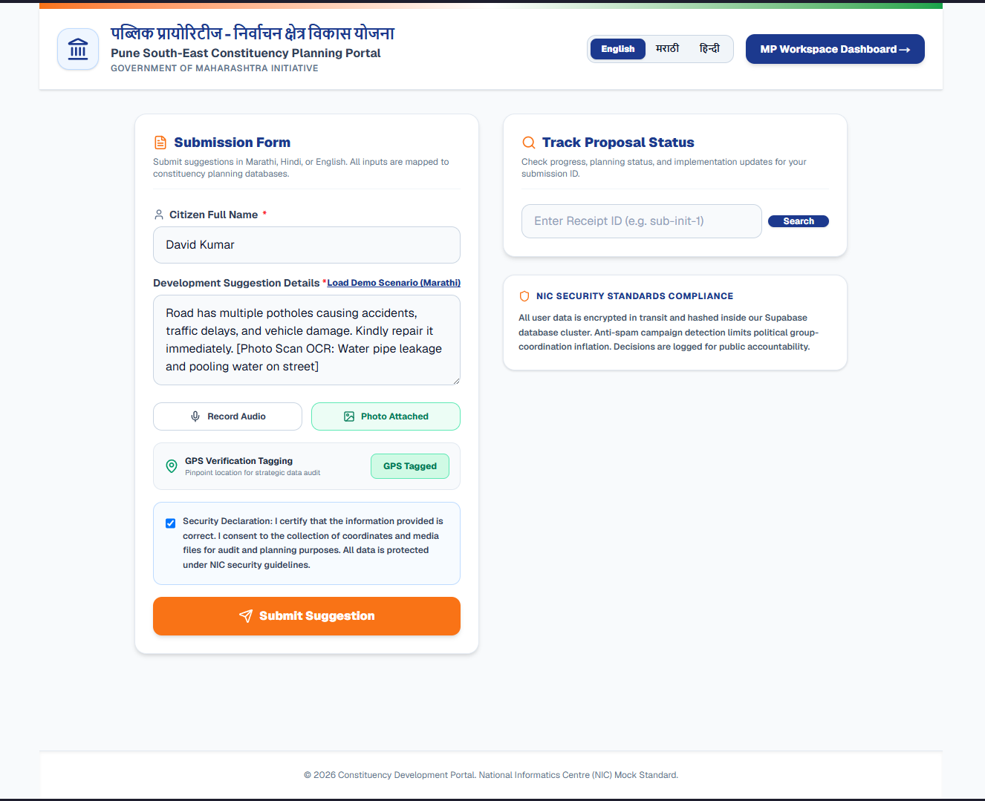
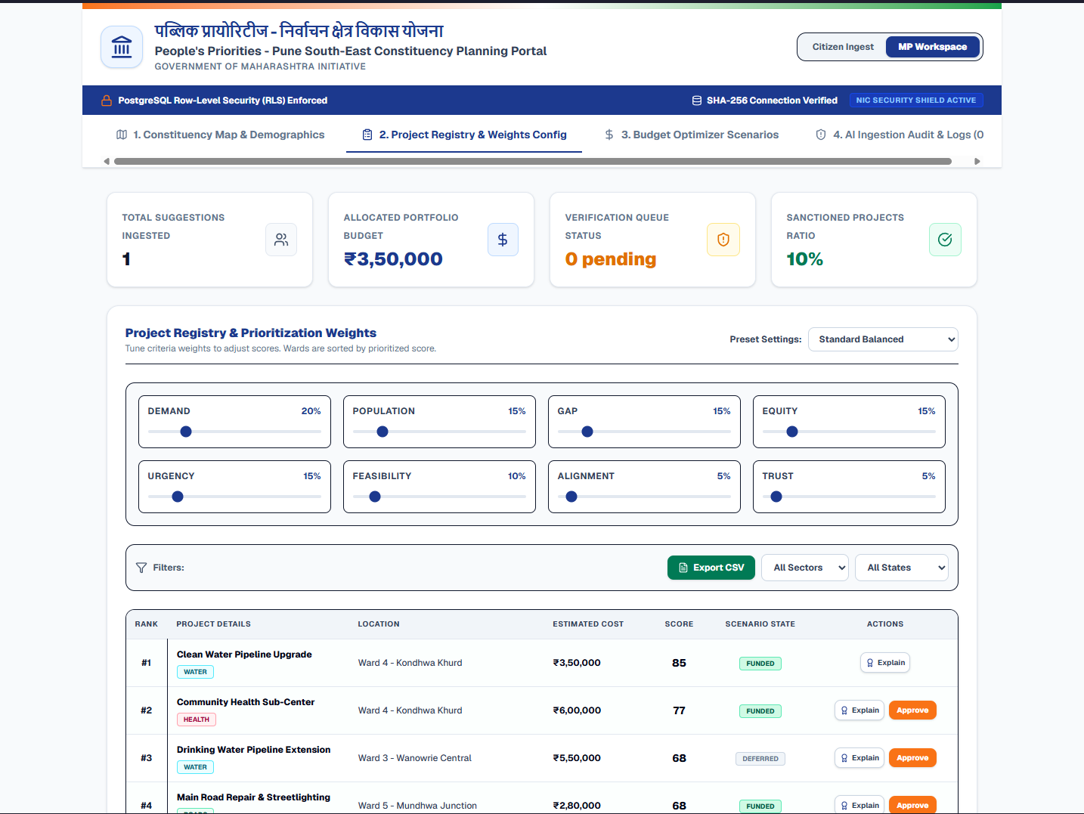
Citizen-to-Government Workflow
Citizen Working Demo
MP Working Demo

Slide 9
Key Innovations
AI Features
Multilingual AI
Explainable Recommendations
Human Verification Queue
Campaign Detection
Semantic Clustering
Budget Optimization
Engineering
Supabase
PostgreSQL
pgvector
API Rate Limiting
XSS Protection
Secure Headers
TTL Cache
Audit Logs

Slide 10
Impact
Today
Transparent planning
Evidence-based prioritization
Reduced manual effort
Better citizen engagement
Faster development planning
Future Scope
Live WhatsApp Integration
Real Government APIs
GIS Analytics
Predictive Development Planning
State-wide Deployment
Transforming Citizen Voices into Transparent Public Decisions
Thankyou

